Slide 1



Slide 2

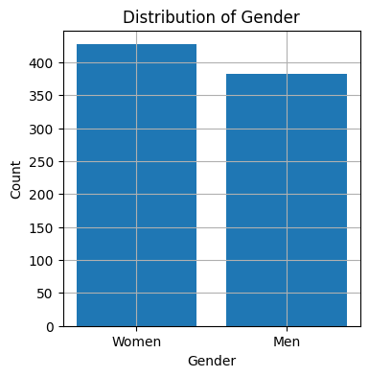
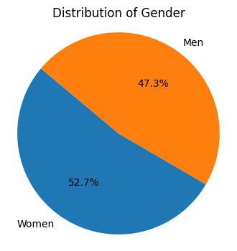
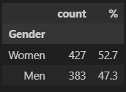
1 Data Exploration:
There are 427 women i.e is 52.7% of population are women
There are 383 men i.e is 47.3% of population are men who are investing
1.1 Demographic Distribution
Gender:
count is the number of entity in the dataset
% is the percentage of unique gender type in total gender type that invests

Slide 3
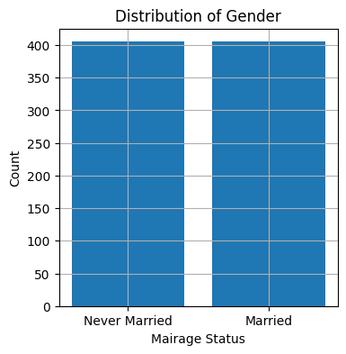
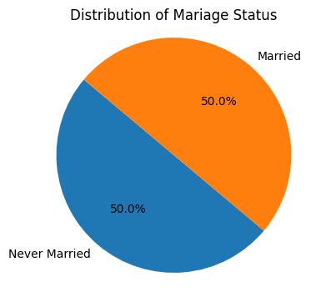
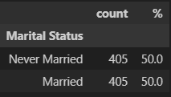
1 Data Exploration:
1.1 Demographic Distribution
Marital Status:
There are 405 unmarried people and 405 married people i.e there is 50% of people are unmarried and 50% are married who invests

Slide 4
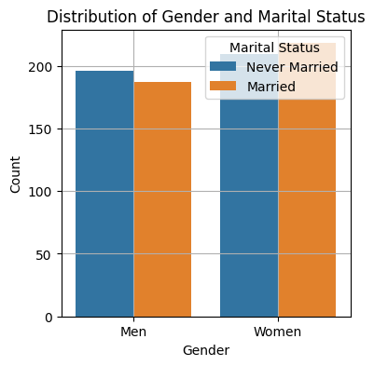
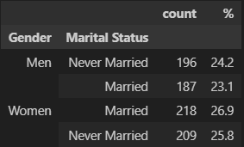
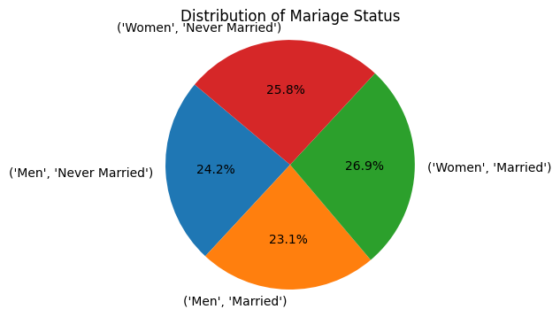
1 Data Exploration:
Marital Status:
There are 196 unmarried men and 187 married men that leads to 24.2% and 23.1% of total population
There are 218 unmarried women and 209 married women that leads to 26.9% and 25.8% of total population that invests
1.1 Demographic Distribution

Slide 5
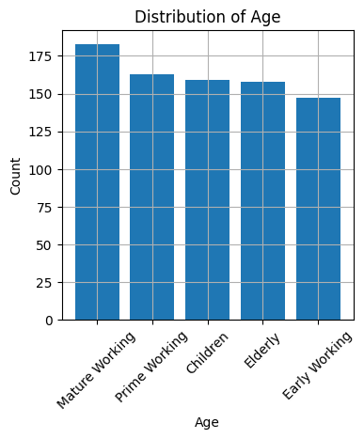
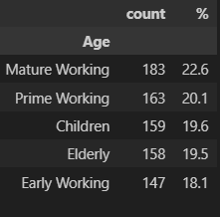
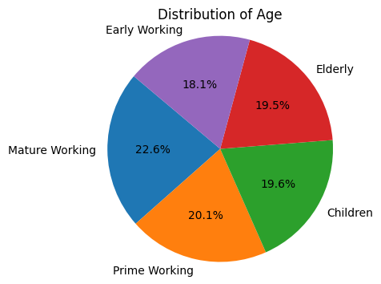
1 Data Exploration:
1.1 Demographic Distribution
Age:
There are 183 mature working, 163 prime working, 159 children, 158 elderly and early 147 working consistuting to be 22.6%, 20.1%, 19.6%, 19.5% and 18.1% that invests

Slide 6
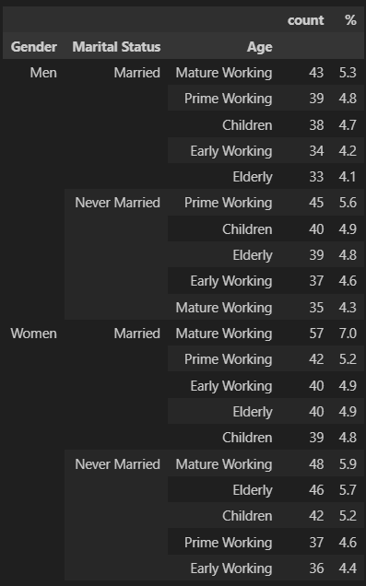
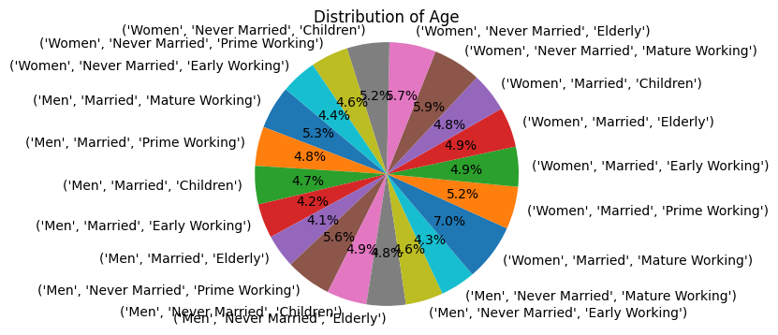
1 Data Exploration:
1.1 Demographic Distribution
Gender , Marital Status and Age
count is the number of entity in the dataset that invests
% is the percentage of unique age, marital statue and age type in total type

Slide 7
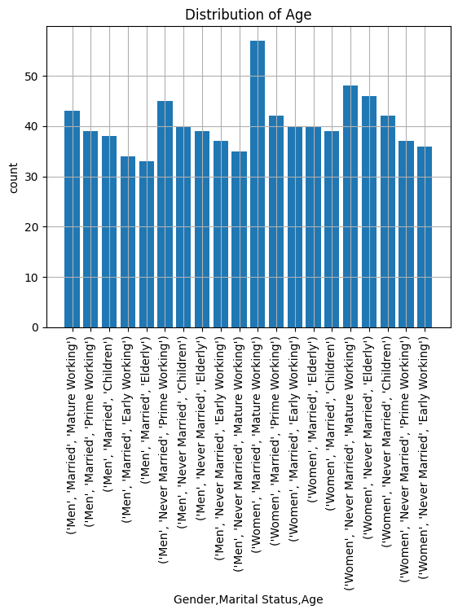
1 Data Exploration:
1.1 Demographic Distribution
Gender , Marital Status and Age

Slide 8
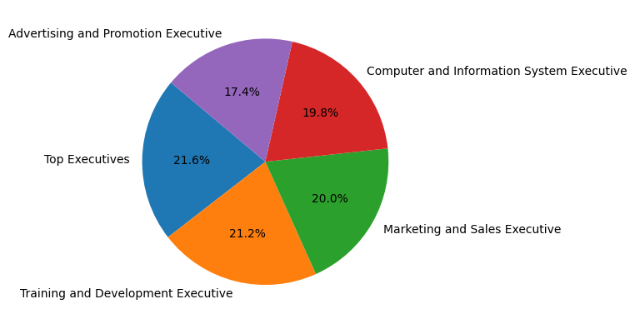
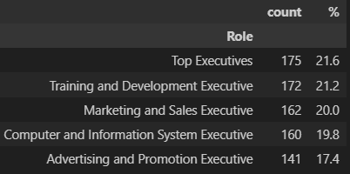
1 Data Exploration:
1.2 Exploration of Role,Career Stages and Income bracket
Role:
count is the number of entity in the dataset who invests
% is the percentage of unique gender type in total gender type that invests
The Top Executives is 175 time giving 21.6%, Training and Development Executive is 172 time giving 21.2%, Marketing and SalesExecutive is 162 times i.e 20%, Computer and Information is 160 times i.e 19.8% and Advertising and Promotion is 141 i.e 17.4% of whole Role who are investing

Slide 9
1 Data Exploration:
1.2 Exploration of Role,Career Stages and Income bracket
Age:
There are 183 mature working, 163 prime working, 159 children, 158 elderly and early 147 working consistuting to be 22.6%, 20.1%, 19.6%, 19.5% and 18.1% who are investing

Slide 10
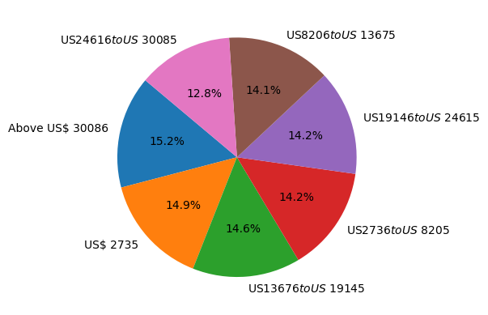
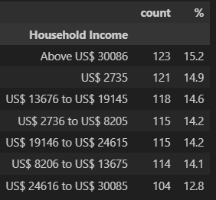
1 Data Exploration:
1.2 Exploration of Role,Career Stages and Income bracket
Household Income:
count is the number of entity in the dataset
% is the percentage of unique gender type in total gender type that invests
The people who earn Above US$ 30086 is 123 time giving 15.2%, US$ 2735 is 121 time giving 14.9%, US$ 13676 to US$ 19145 is 118 times i.e 14.6%, US$ 2736 to US$ 8205 is 115 times i.e 14.2%, US$ 2736 to US$ 8205 is 115 times i.e 14.2%, US$ 19146 to US$ 24615 is 115 times i.e 14.2%, US$ 8206 to US$ 13675 is 114 times i.e 14.1% and US$ 24616 to US$ 30085 is 104 i.e 12.8% of whole Role that are ready to invest

Slide 11
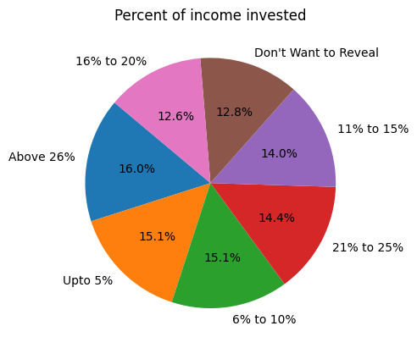
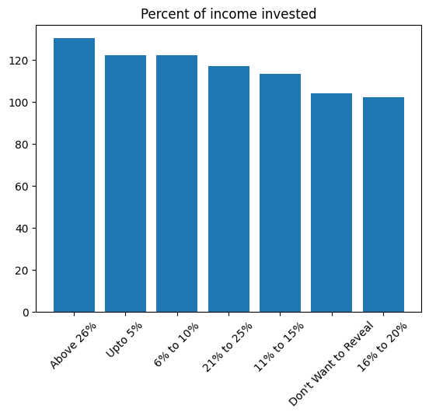
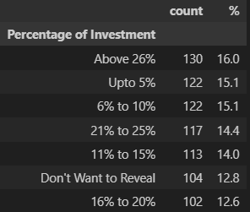
1 Data Exploration:
1.3 Behavior insights % of income invested, source of awareness, level of knowledge in investments, risk level, reason for investments
% of Income Invested:
130 people invest above 26% of their income i.e 16%
122 people invest upto of their income i.e 15.1%
122 people invest 6% to 10% of their income i.e 15.1%
117 people invest 21% to 25% of their income i.e 14.4%
113 people invest 11% to 15% of their income i.e 14%
104 people don’t want to reveal i.e 12.8%
102 people invest 16% to 20% of their income i.e 12.6%

Slide 12
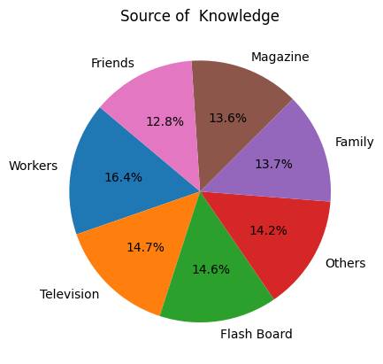
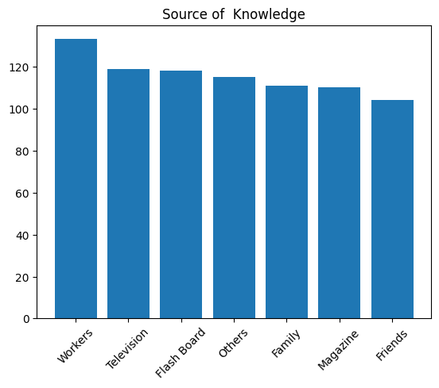
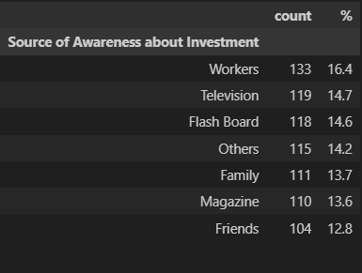
1 Data Exploration:
1.3 Behavior insights % of income invested, source of awareness, level of knowledge in investments, risk level, reason for investments
Source of Awareness:
133 people have awareness via Workers i.e 16%
119 people have awareness via Television i.e 14.7%
118 people have awareness via Flash Board i.e 14.6%
115 people have awareness via others i.e 14.2%
111 people have awareness via Family i.e 13.7%
110 people have awareness via Magzine i.e 13.6%
104 people have awareness via Friends i.e 12.8%

Slide 13
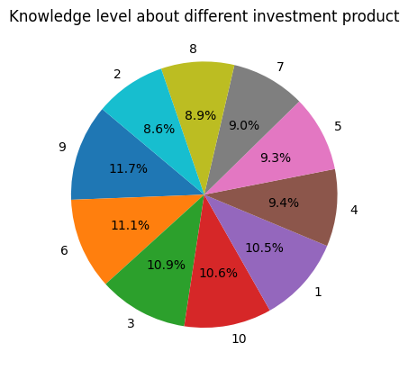
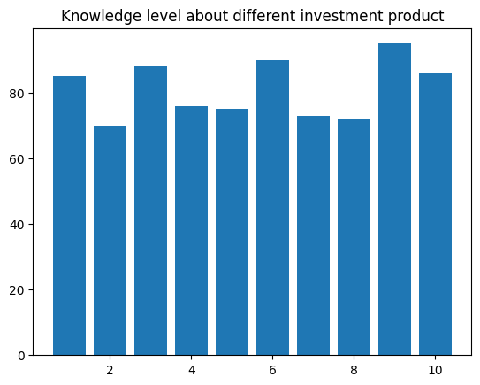
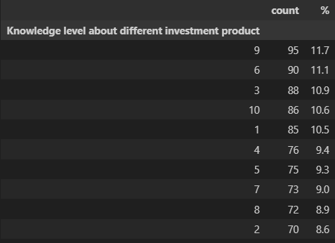
1 Data Exploration:
1.3 Behavior insights % of income invested, source of awareness, level of knowledge in investments, risk level, reason for investments
Level of Knowledge in investments products graded(1-10):
95 people graded with 9 i.e 11.7%
90 people graded with 6 i.e 11.1%
88 people graded with 3 i.e 10.9%
86 people graded with 10 i.e 10.5%
85 people graded with 1 i.e 10.5%
76 people graded with 4 i.e 9.4%
75 people graded with 5 i.e 9.3%
73 people graded with 7 i.e 9%
72 people graded with 8 i.e 8.9%
70 people graded with 2 i.e 8.6%

Slide 14
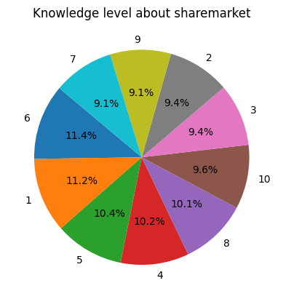
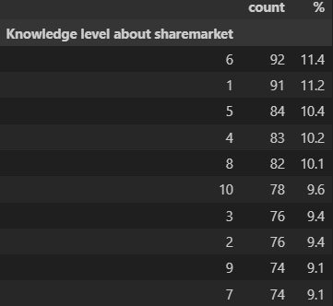
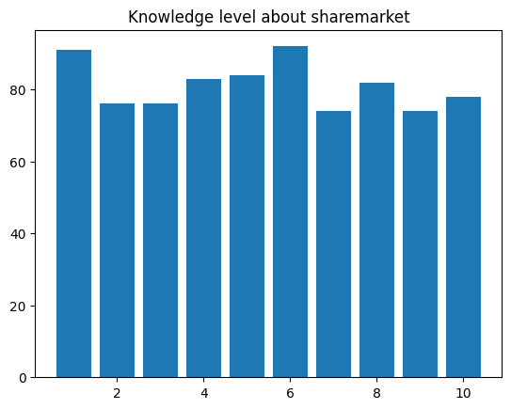
1 Data Exploration:
1.3 Behavior insights % of income invested, source of awareness, level of knowledge in investments, risk level, reason for investments
Level of Knowledge in share markets graded(1-10):
92 people graded with 6 i.e 11.4%
91 people graded with 1 i.e 11.2%
84 people graded with 5 i.e 10.4%
83 people graded with 4 i.e 10.2%
82 people graded with 8 i.e 10.1%
78 people graded with 10 i.e 9.6%
76 people graded with 3 i.e 9.4%
76 people graded with 2 i.e 9.4%
74 people graded with 9 i.e 9.1%
74 people graded with 7 i.e 9.1%

Slide 15
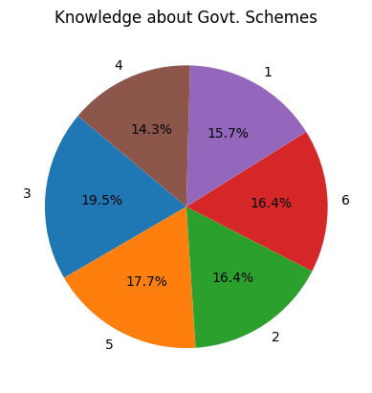
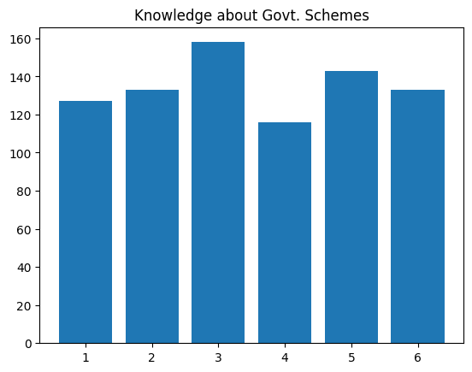
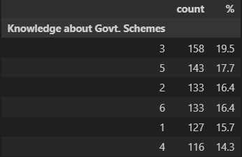
1 Data Exploration:
1.3 Behavior insights % of income invested, source of awareness, level of knowledge in investments, risk level, reason for investments
Level of Knowledge in Govt. Schemes graded(1-6):
158 people graded with 3 i.e 19.5%
143 people graded with 5 i.e 17.7%
133 people graded with 2 i.e 16.4%
133 people graded with 6 i.e 16.4%
127 people graded with 1 i.e 15.7%
116 people graded with 4 i.e 14.3%

Slide 16
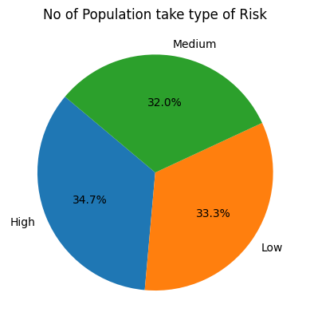
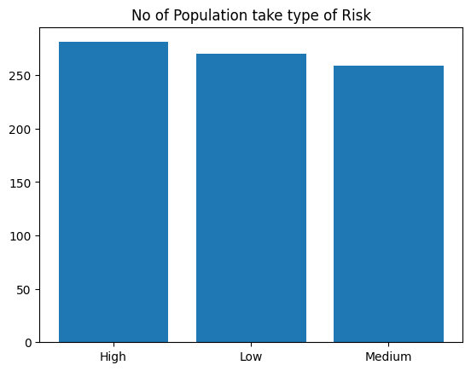
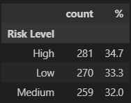
1 Data Exploration:
1.3 Behavior insights % of income invested, source of awareness, level of knowledge in investments, risk level, reason for investments
Individuals willingness to take investment hisks:
281 people takes high risks i.e 34.7%
270 people takes low risks i.e 33.3%
259 people takes high risks i.e 32.0%

Slide 17
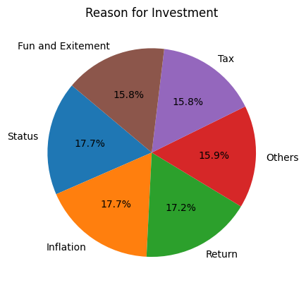
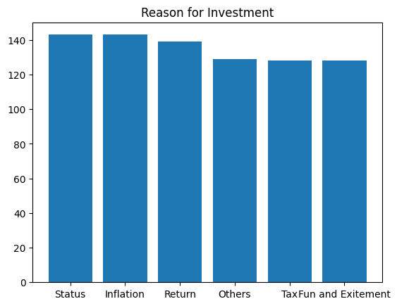
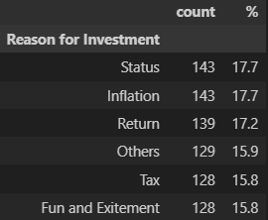
1 Data Exploration:
1.3 Behavior insights % of income invested, source of awareness, level of knowledge in investments, risk level, reason for investments
Reason for investments:
143 people invest bcoz of Status i.e 17.7%
143 people invest bcoz of Inflation i.e 17.7%
139 people invest bcoz of Return i.e 17.2%
129 people invest bcoz of Others i.e 15.9%
128 people invest bcoz of Tax i.e 17.7% 128 people invest bcoz of Fun i.e 17.2%

Slide 18
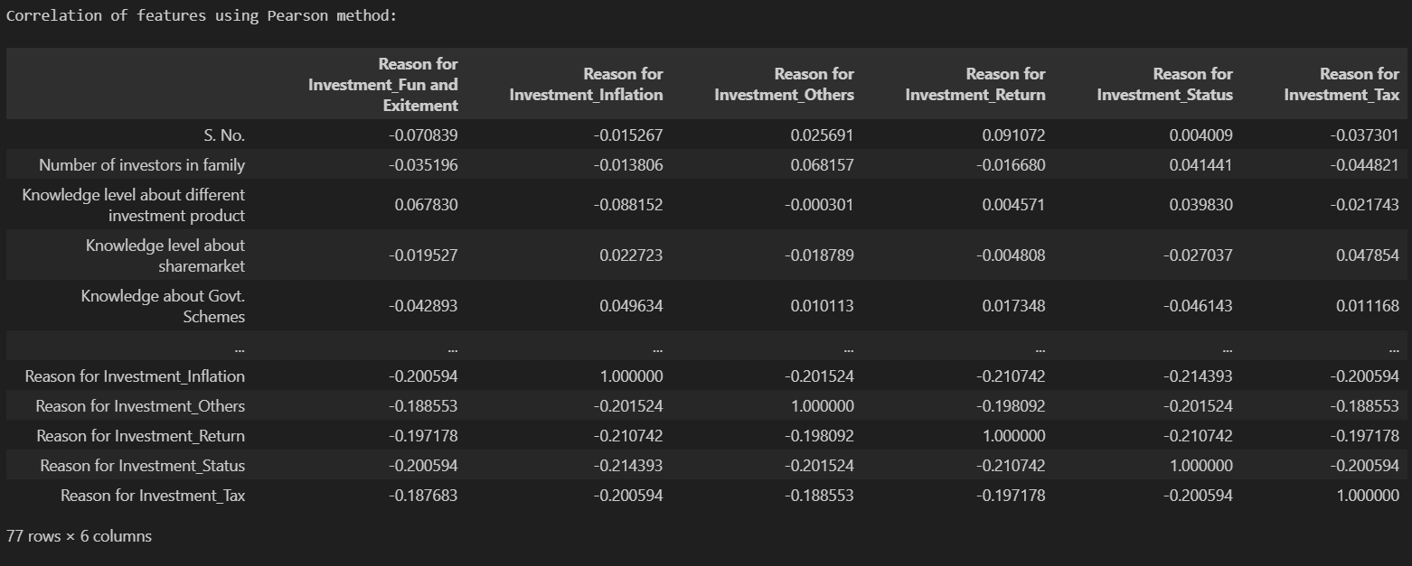
Correlation of Target with Features
Correlation shows the contribution of features amongst them selves. That means their impact on other features
It one features changes

Slide 19
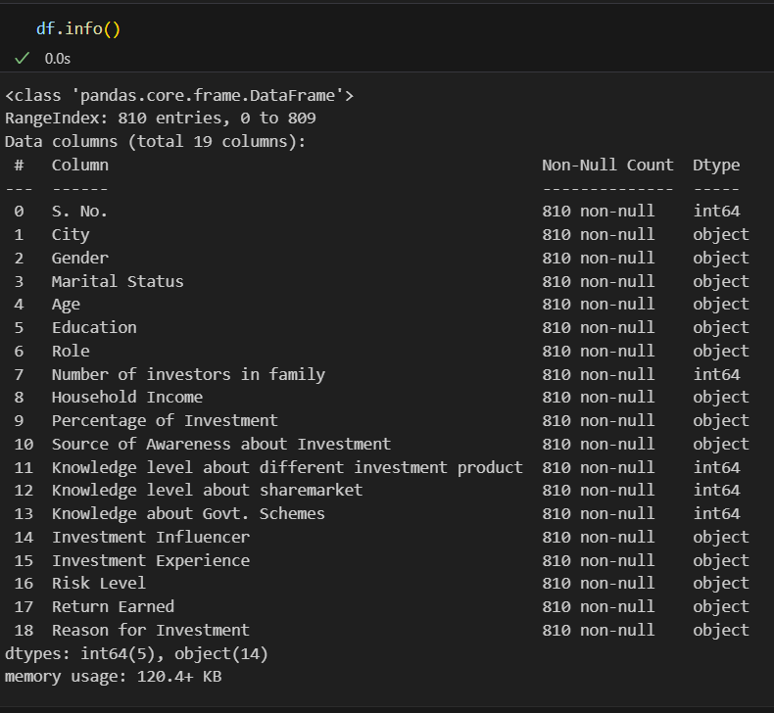
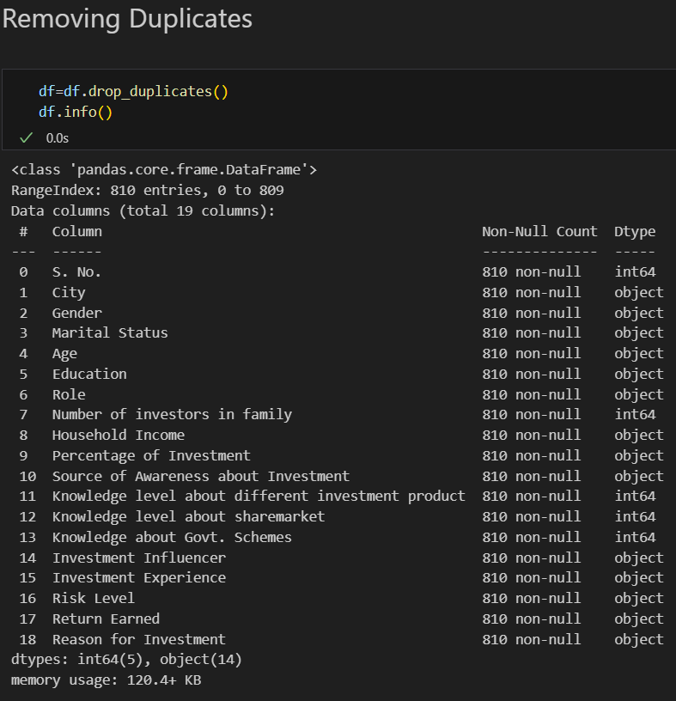
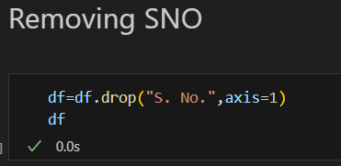
Preprocessing
No Nan Values
Analyzing Data
No Duplicates
Removing Sno

Slide 20
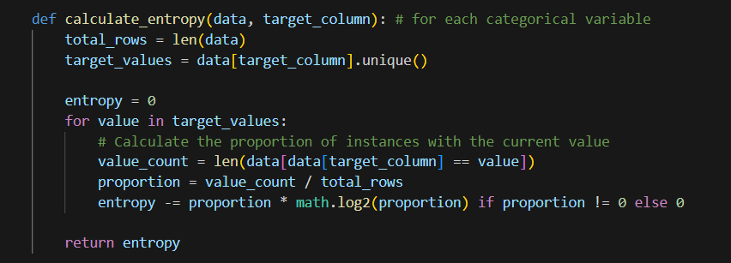

Model Creation
DecissionTree: ID3 (Entropy)
Entropy:
Entropy in information theory measures how much information is expected to be gained upon measuring a random variable
Entropy$=−\sum_{i=1}^{n}{p_{i}\log_{2}{p_{i}}}$

Slide 21
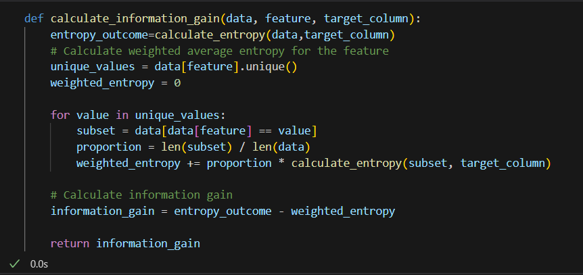

Model Creation
DecissionTree: ID3 (Entropy)
Information Gain:
Information Gain calculates the reduction in the entropy and measures how well a given feature separates or classifies the target classes
IG$=E−p∗\sum_{i=1}^{n}{p_{i}\log_{2}{p_{i}}}$

Slide 22
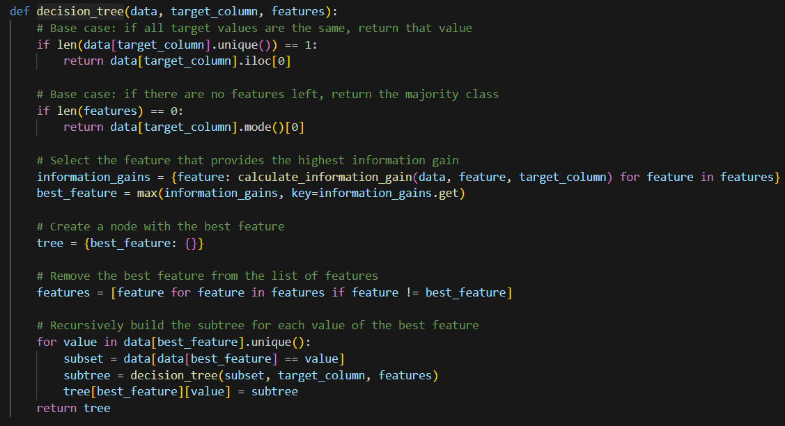
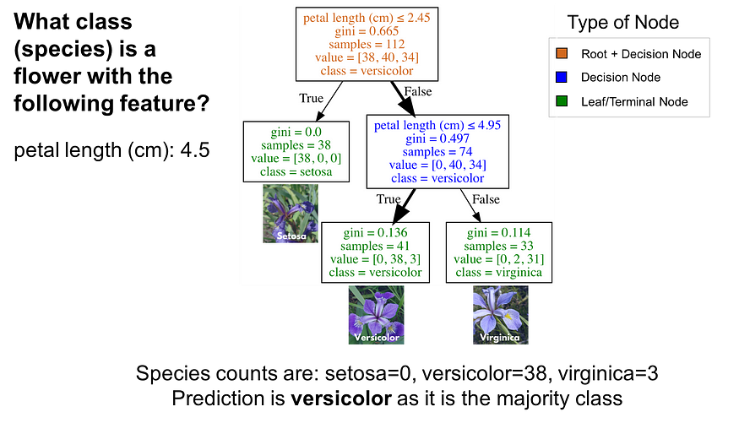
Model Creation
DecissionTree: ID3 (Entropy)
Decission_tree will recursively search for next best feature until outcome is obtained for subsets of current feature

Slide 23
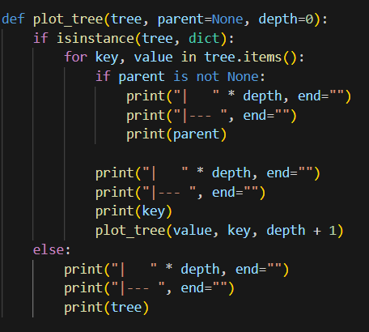
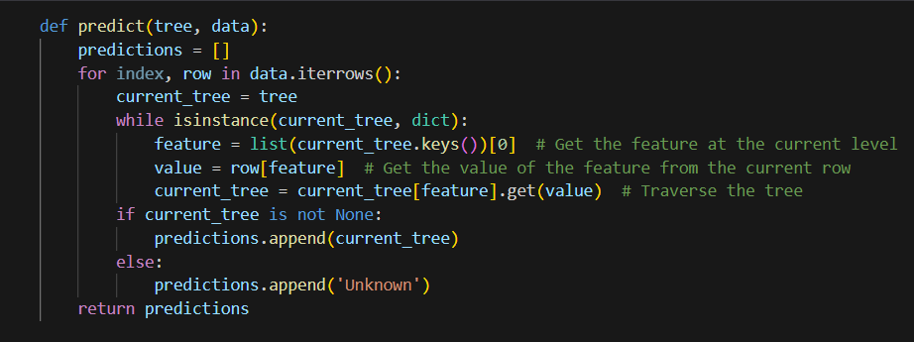

Validation
DecissionTree: ID3 (Entropy)
Predict function is to predict the outcome of entered feature values using decision tree
Plot tree is to plot the ID3 tree having root with maximum IG
Arrange_xtest_data func is used to arrange the new set of data wrt to nodes supremacy (IG) of tree

Slide 24

Model Creation
DecissionTree: ID3 (Entropy)
2
Kl - sm
Kl -ip
6
Kl -ip
>=5%
6
Ploting of Tree
Highest feature Kl of sharemarkets for which there are different values like 2,6
For kl of sharemarket 2 next node is kl of product and so on
pI<=5%
Tax

Slide 25


Classification report, confusion matrix and Validation by ramdom data
A classification report is a text summary that shows the main metrics for each class of a machine learning model. It usually includes the precision, recall, F1-score, and support for each class, as well as the weighted average of these metrics across all classes.

Slide 26


Classification report, confusion matrix and Validation by ramdom data
User input provision for users enter scenario and predict conclusion
The confusion matrix can be used to calculate a variety of metrics, such as accuracy, precision, recall, and F1 score. These metrics can be used to evaluate the performance of a classification model and to identify areas where the model can be improved.

